Slide 1
Support Vector Machine (SVM)
Notes:
1

Slide 2
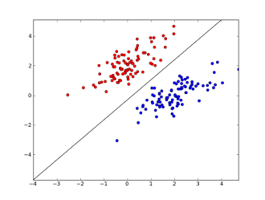
SVM
Linear Discriminants
Notes:
2

Slide 3
SVM
Linear Discriminants
Notes:
3

Slide 4
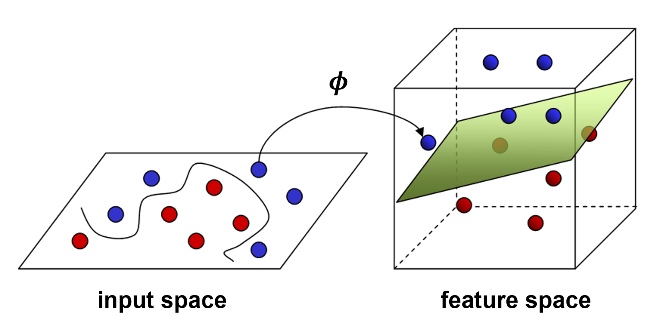
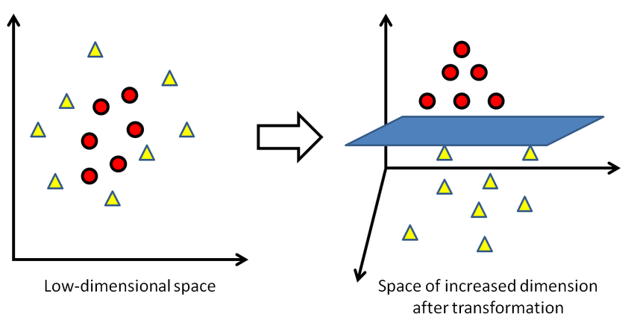

SVM
Polynomial Fitting: Linearity?
$$y_{i}=w_{0}+w_{1}x_{i1}+w_{2}x_{i2}+w_{3}x_{i1}^{2}+w_{4}x_{i2}^{2}+w_{5}x_{i1}x_{i2}$$
Notes:
4

Slide 5
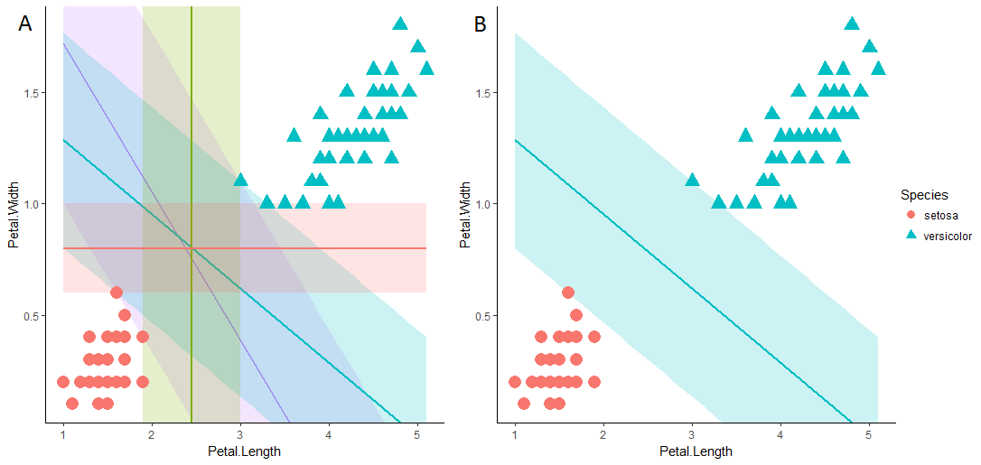
SVM
Maximum Margin Discriminant
Notes:
5

Slide 6
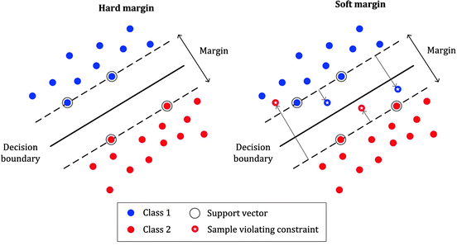
SVM
Hard Margin vs Soft Margin
Notes:
6

Slide 7
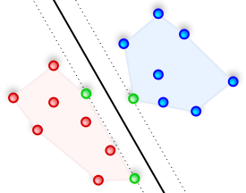
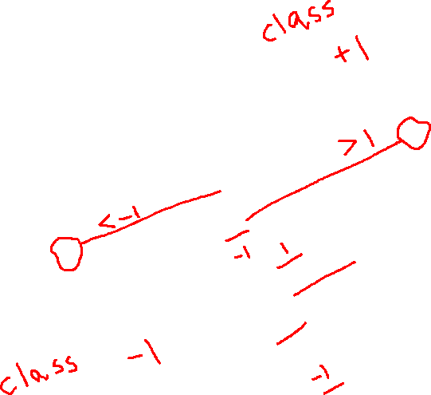
SVM
Confidence
Notes:
7

Slide 8
SVM
Multiclass SVM
One vs the Rest (Softmax)
Notes:
8

Slide 9
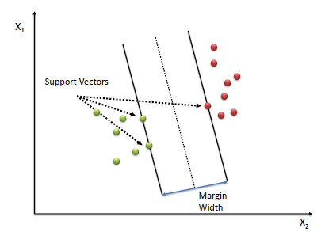
SVM
SVM vs Logistic Regression
Sparsity
Notes:
9

Slide 10
SVM
SVM Optimization Problem
Find out a separating surface (Decision Surface/boundary) such that even the closest point to the surface is as far away as possible.
Notes:
10

Slide 11

SVM
$$y_{i}=sign(w^{T}x_{i}+w_{0})$$
Notes:
11

Slide 12
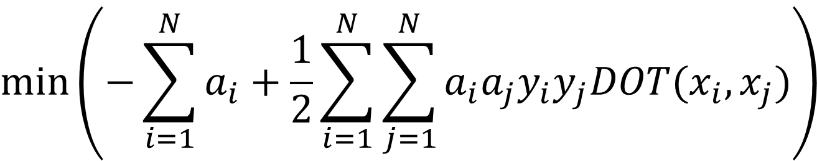



SVM
$$min⁡\left(−\sum_{i=1}^{N}{a_{i}+\frac{1}{2}\sum_{i=1}^{N}{\sum_{j=1}^{N}{a_{i}a_{j}y_{i}y_{j}DOT(x_{i},x_{j})}}}\right)$$
$$0≤a_{i}≤C$$
$$w=\sum_{i=1}^{N}{a_{i}y_{i}x_{i}}$$
$$\sum_{i=1}^{N}{a_{i}y_{i}=0}$$
Notes:
12

Slide 13
SVM
Kernels
Notes:
13

Slide 14
Data Preparation Python
Numeric Data (Numpy)
Data Loading (Pandas)
Data Visualization (Matplotlib)
Data Encoding (String)
Notes:
14

Slide 15
SVM With sklearn
Numeric Data (Numpy)
Data Standardization (sklearn)
SVM(sklearn)
Notes:
15

Slide 16
SVM Without sklearn
Numeric Data (Numpy)
Data Standardization (sklearn)
Optimization (cvxopt)
Notes:
16

Slide 17
SVM With sklearn
Cross Validation and hyper parameters
Notes:
17

Slide 18

SVM Mathematics
Generalized Linear Model
$$y_{i}=f(w^{T}x_{i}+w_{0})$$
Notes:
18

Slide 19

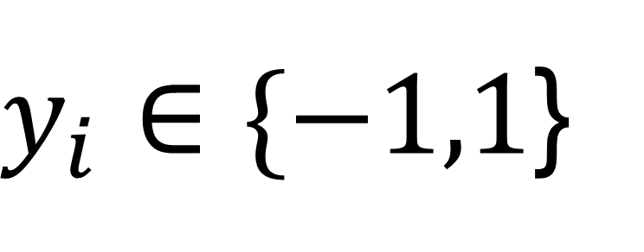
SVM Mathematics
$y_{i}∈\{−1,1$}
For Binary SVM
$$y_{i}=sign(w^{T}x_{i}+w_{0})$$
Notes:
19

Slide 20

SVM Mathematics
$y_{i}∈\{−1,1$}
For Binary SVM
$$y_{i}=sign(w^{T}{φ(x}_{i})+w_{0})$$
Notes:
20

Slide 21


SVM Mathematics
Confidence
$${\left\|w^{T}{φ(x}_{i})+w_{0} \right\|}^{ }$$
$${{y_{i}(w}^{T}{φ(x}_{i})+w_{0})}^{ }$$
Notes:
21

Slide 22

SVM Mathematics
Confidence
$$\frac{{y_{i}(w}^{T}{φ(x}_{i})+w_{0})}{\left\|w\right\|}$$
Algebraic Distance vs Geometric Distance
Notes:
22

Slide 23

SVM Mathematics
SVM Optimization Problem
$${}_{w,w_{0 }}^{argmax}{\{ \frac{1}{\left\|w\right\|} {}_{i }^{min}{ \left[y_{i}\left(w^{T}∅\left(x_{i}\right)+w_{0}\right)\right]} \}}$$
Notes:
23

Slide 24


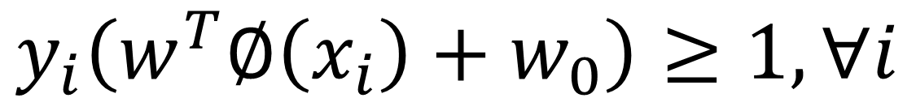
SVM Mathematics
SVM Optimization Problem (Hard Margin)
$${}_{ }^{ }{{}_{i }^{min}{ \left[y_{i}\left(w^{T}∅\left(x_{i}\right)+w_{0}\right)\right]}=1}$$
We can always scale algebraic distance
$$\frac{1}{2}{\left\|w\right\|}^{2}$$
Minimize
$$y_{i}\left(w^{T}∅\left(x_{i}\right)+w_{0}\right)≥1,∀i$$
Subject to
Notes:
24

Slide 25

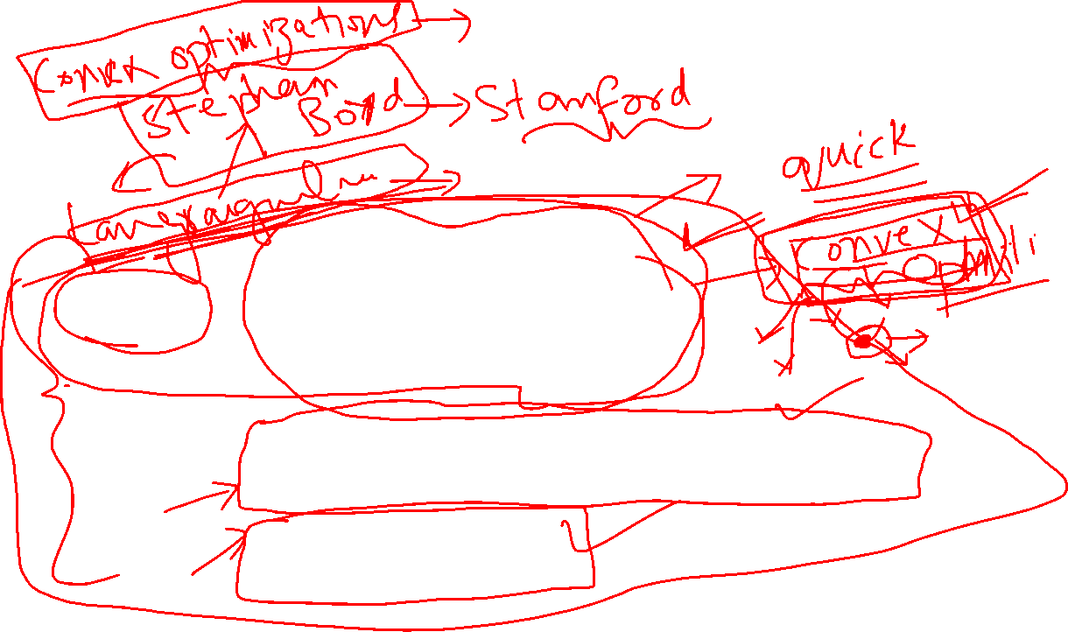
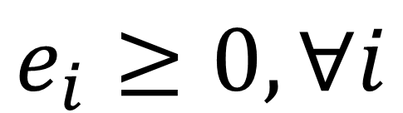

SVM Mathematics
SVM Optimization Problem (Soft Margin)
$$\frac{1}{2}{\left\|w\right\|}^{2}+C\sum_{i=1}^{N}{e_{i}}$$
Minimize
$$y_{i} \left(w^{T}∅\left(x_{i}\right)+w_{0}\right)≥1−e_{i} ,∀i$$
Subject to
$$e_{i}≥0,∀i$$
Notes:
25

Slide 26
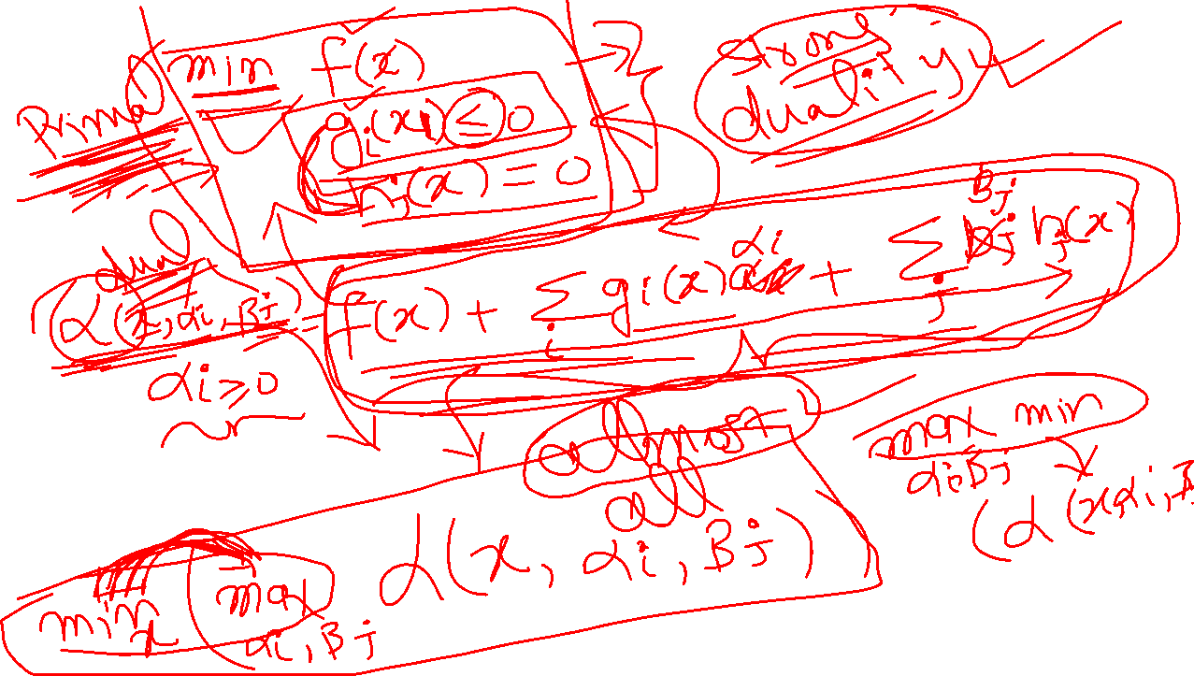

Slide 27
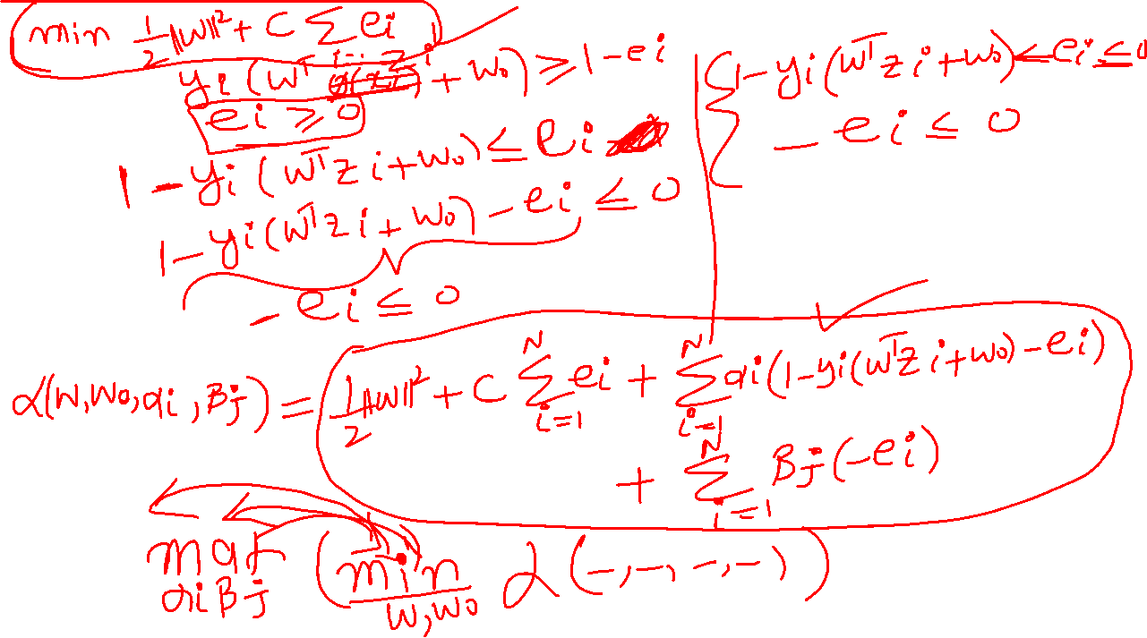
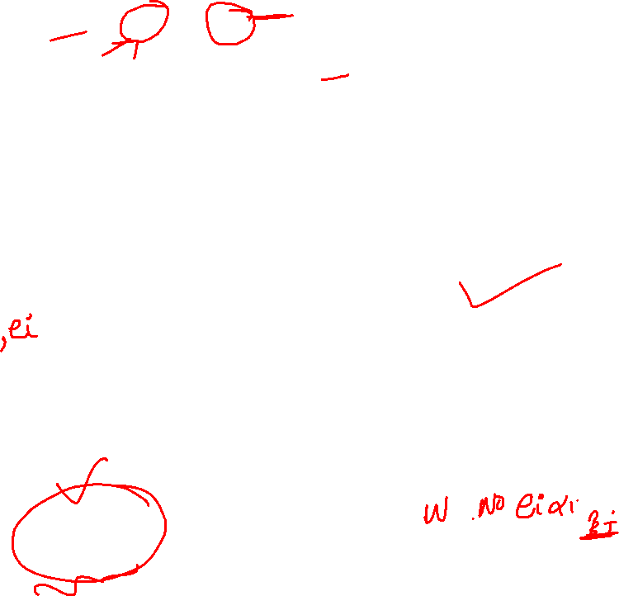

Slide 28
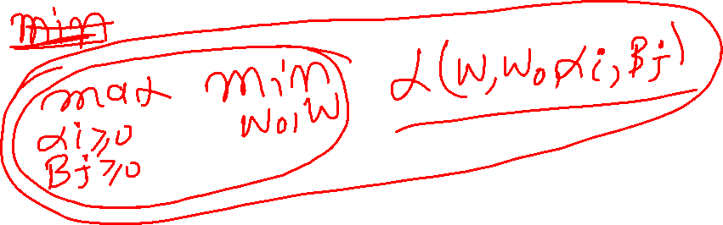
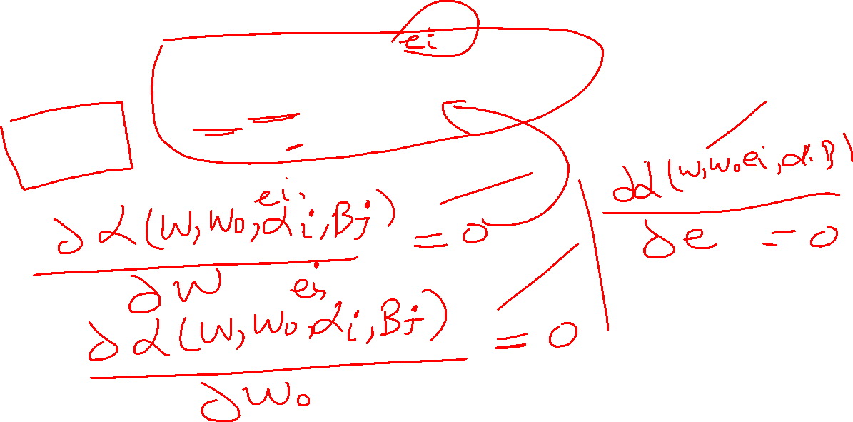

Slide 29
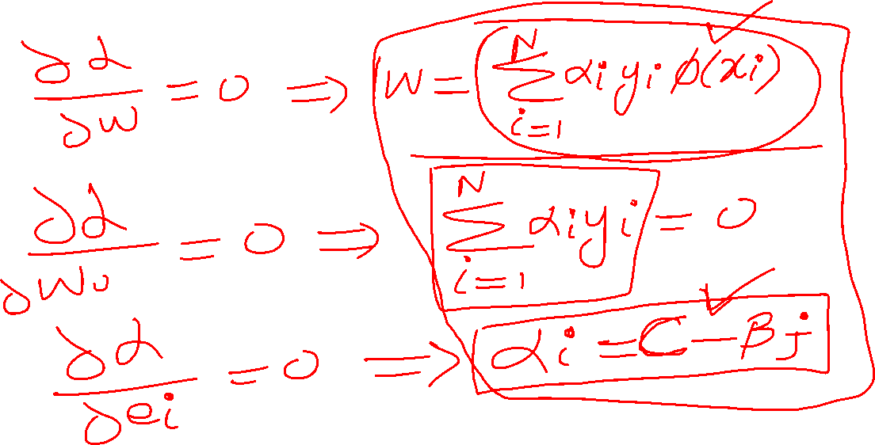

Slide 30
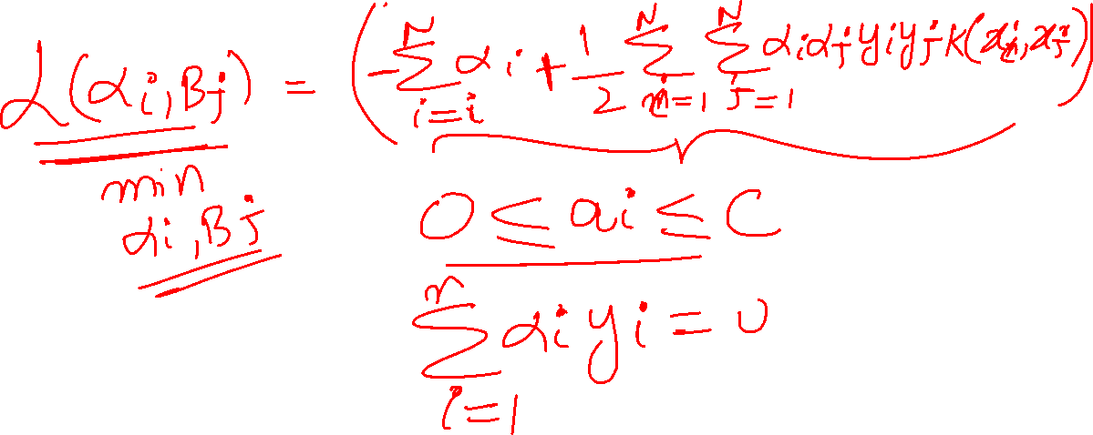

Slide 31
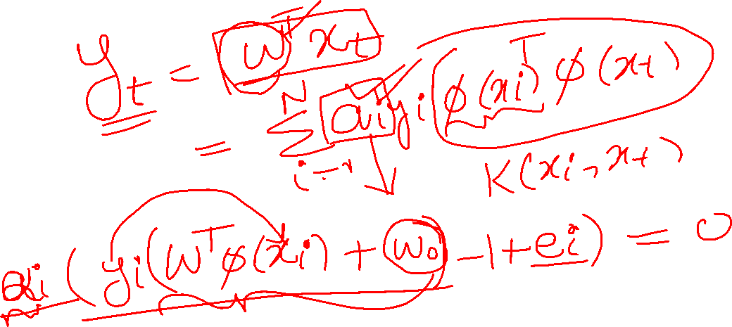

Slide 32
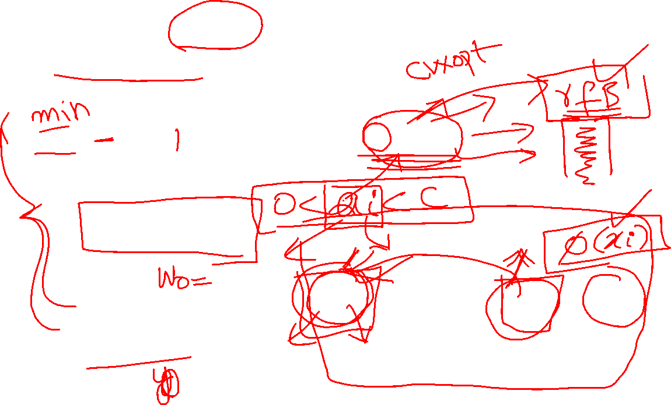




SVM Mathematics
Langragian Dual and the Kernels
$$max⁡\left(\sum_{i=1}^{N}{a_{i}−\frac{1}{2}\sum_{i=1}^{N}{\sum_{j=1}^{N}{a_{i}a_{j}y_{i}y_{j}k(x_{i},x_{j})}}}\right)$$
$$0≤a_{i}≤C$$
$$w=\sum_{i=1}^{N}{a_{i}y_{i}x_{i}}$$
$$\sum_{i=1}^{N}{a_{i}y_{i}=0}$$
Notes:
32

